Slide 1
Chapter 14:
Technologies are available to assist in reproduction

Slide 2
14.1 Treatment of infertility
Infertility is defined as being unable to achieve pregnancy despite frequent unprotected sex over the period of at least a year. In Australia, infertility affects approximately one in six couples.
Causes of infertility
About 40% of infertility is due to problems with the sperm. Another 40% is due to problems in the female reproductive system, while the remaining 20% is due to a combination of male and female factors.

Slide 3
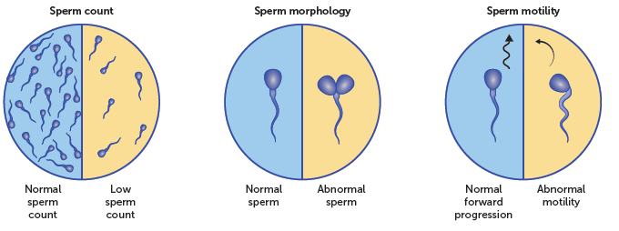
14.1 Treatment of infertility
Sperm production
For sperm to be able to fertilise an egg, it must be:
• produced in sufficient quantities
• able to move in a forward direction
• able to penetrate the corona radiata and zona pellucida.
This means that there needs to be a high number of sperm produced with a correct structure. Problems with any of these qualities will greatly reduce the chance of a pregnancy.

Slide 4
14.1 Treatment of infertility
Other factors affecting male fertility
Other factors that may result in sperm being unable to fertilise an egg include:
Semen, and the sperm it contains, may flow into the bladder, rather than out the urethra.
The male’s immune system may develop antibodies for their own sperm, altering them and reducing their effectiveness.
Blockages may occur in the male’s reproductive tract, especially in the vas deferens, which may stop the sperm leaving the testes.
Hormonal imbalances can affect sex drive and the production of sperm.

Slide 5
14.1 Treatment of infertility
Ovulation
As females get older, the number of healthy eggs remaining decreases. This greatly reduces the chance of pregnancy, especially after the age of 36.
Polycystic ovarian syndrome (PCOS) is another factor affecting the fertility of females. PCOS is a hormonal condition where the ovaries contain many partially formed follicles that fail to mature. This means that the eggs are not released, and therefore cannot be fertilised.
Hyperprolactinemia, which means high levels of the hormone prolactin, may occur in people with pituitary tumours, hypothyroidism and PCOS. The high level of prolactin results in intermittent or a lack of ovulation.
Once a female has gone through menopause, she will no longer be ovulating and therefore will be unable to get pregnant.
Cancer treatments may also cause primary ovarian insufficiency, and hence infertility. In women younger than 30, this may be temporary, and they may become fertile again after treatment.

Slide 6
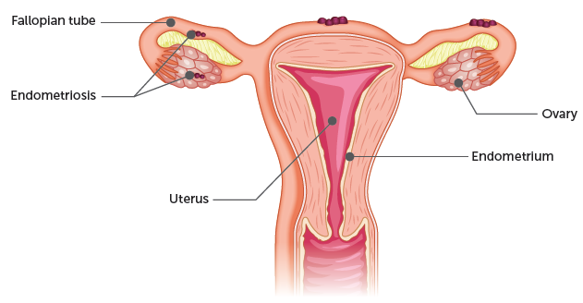
14.1 Treatment of infertility
Other factors affecting female fertility
Endometriosis affects approximately 10% of women. It is a painful condition where the cells of the endometrium grow outside the uterus. The resulting scar tissue or distortion of the uterine tubes can affect fertility by blocking the egg’s release or pathway through to the uterus.

Slide 7
14.1 Treatment of infertility
Other factors that may affect fertility include:
Fibroids: benign growths in the muscular part of the uterus. While very common, they only affect fertility if their location distorts the uterine cavity or blocks the uterine tubes.
Blockages of the uterine tubes: stops the egg passing through to the uterus. This can occur following infections, such as gonorrhoea or chlamydia, or damage – for example, due to ectopic pregnancies.
Problems with the menstrual cycle: can affect fertility as it influences implantation of the blastocyst. Hormonal imbalances can reduce the development of the endometrium and its maintenance.

Slide 8
14.1 Treatment of infertility
Infertility treatments that allow unassisted fertilisation
Surgery
Microsurgery can be used to solve some problems of infertility. Blocked uterine tubes and sperm ducts can be opened, and fibroids or endometriosis can be removed.
Ovulation tracking
It is possible to identify the time when a female is most fertile through a series of blood tests. There is a surge in luteinising hormone prior to ovulation. The level of the hormone can be monitored through blood tests so that a couple knows when they are most likely to conceive. Sperm remain viable for two to three days in the uterine tubes, while the egg only survives for 24 hours. Therefore, the highest chance of conception occurs by insemination prior to ovulation. If a couple tracks the ovulation of the female over a number of cycles, it is possible to identify the most effective time to have sexual intercourse.

Slide 9
14.1 Treatment of infertility
Ovulation induction
In some cases, infertility is due to problems with ovulation resulting from a low level of hormones. These problems may be solved by medications used to correct the problem. Two types of drugs are used, both of which use follicle-stimulating hormone (FSH) to induce the development of follicles.
• Clomiphene stimulates the body to make more FSH.
• Hormone injections of FSH increase the blood levels of the hormone.
Another hormone, human chorionic gonadotrophin (hCG), may also be used to trigger ovulation once the follicle has matured.

Slide 10
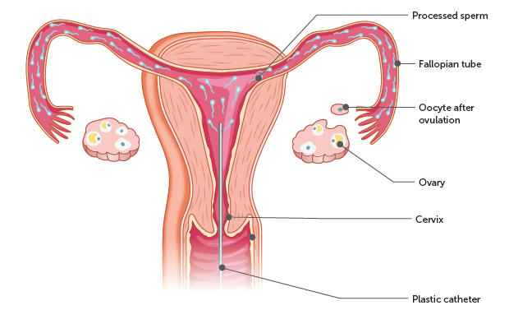
14.1 Treatment of infertility
Artificial insemination
Artificial insemination, or intrauterine insemination (IUI), is a process where sperm is released into the uterus by a catheter being inserted through the cervix. The sperm sample is then injected through the catheter. From the uterus, the sperm are able to move naturally through the uterine tubes where they may fertilise an egg. IUI increases the chance of pregnancy for affected couples by increasing the number of sperm that reach the uterine tubes.

Slide 11
14.1 Treatment of infertility
The sperm used may be the male partner’s or from a donor male. In both instances, the sperm is collected, analysed, processed and concentrated. Sperm can also be frozen for use at a later time.
There are a range of circumstances that would benefit from IUI:
• males with a low sperm count or decreased motility
• ejaculation dysfunctions
• sperm stored and frozen due to a male’s absence or needing to undergo treatment such as chemotherapy or radiotherapy
• females with cervical scarring
• hostile cervical mucus
• same sex couples
• single females.
The success rate of IUI is relatively high.

Slide 12
14.1 Treatment of infertility
Assisted fertilisation
Gamete intrafallopian transfer (GIFT)
GIFT is a procedure that can be performed when there are normal uterine (or fallopian) tubes and adequate sperm. It involves the following steps:
Hormonal treatment is used to stimulate the female to produce more than one egg.
The sperm and egg are collected and analysed.
The sperm and egg are mixed together in the laboratory.
The sperm and egg mixture is injected into the woman’s uterine tubes during laparoscopic surgery.
It is hoped that the sperm will then fertilise the egg naturally and move down the uterine tube before implanting in the uterus.

Slide 13
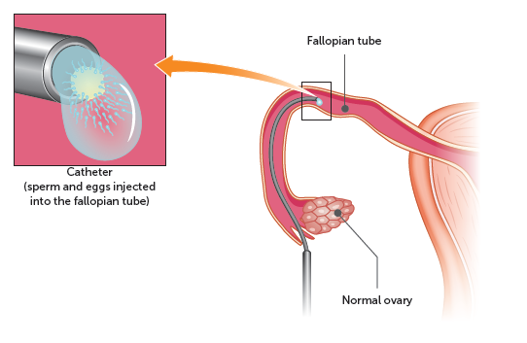
14.1 Treatment of infertility
As advancements have been made in other areas of assisted reproductive technologies, the frequency of GIFT procedures has decreased. GIFT has the disadvantages of having a lower pregnancy rate and requiring surgery.
However, as fertilisation occurs naturally, this method is preferred by some couples.

Slide 14
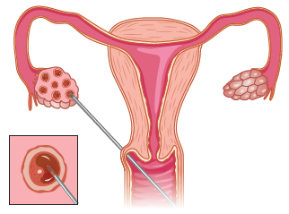
14.1 Treatment of infertility
In vitro fertilisation (IVF)
IVF is used to overcome a range of fertility issues, such as blocked uterine tubes, ovulation disorders, endometriosis, fibroids, low sperm quality or production, and unexplained infertility.
During IVF, hormonal treatment is used to:
• stimulate the ovaries so that multiple follicles develop
• control ovulation
• prepare the uterine lining.
A series of blood tests and ultrasounds are used to monitor the development of the follicles. When the eggs are mature, they are collected by a needle passing through the vagina to the ovaries (see diagram).
Following their retrieval, the eggs are mixed with sperm in a suitable environment at 37°C to maximise their chances of fertilisation and development. Approximately 2−6 days after collection, an embryo is inserted into the uterus via a catheter passed through the cervix.

Slide 15
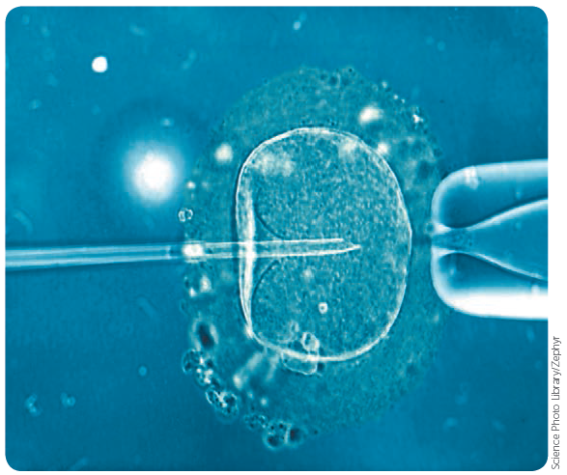
14.1 Treatment of infertility
Intracytoplasmic sperm injection (ICSI)
If there is a problem with the sperm, it is likely that it will not be able to fertilise the egg unassisted. This means that IVF has a low chance of success. ICSI is very similar to IVF. Once the eggs have been collected, they are examined to ensure that they are suitable. A sperm is then injected into the egg, achieving fertilisation. The resulting cells are then monitored, and any that are developing normally are able to be inseminated.
Male infertility may be a genetic disorder, therefore it is recommended that children born from ICSI are examined by a paediatrician. It is also possible for genetic testing to be done prior to undertaking ICSI.
Sperm being injected into an egg

Slide 16
14.1 Treatment of infertility
Other options for pregnancy
Donor gametes or embryos
It is possible to use eggs, sperm or embryos from donors to achieve a pregnancy. The donor may be known to the couple, or anonymous. In Australia, there are strict regulations regarding donors, including counselling for both donors and recipients, cooling-off periods and health screening.
Surrogacy
If a female is unable to conceive or carry a baby, surrogacy is an option that they may consider. With this arrangement, another woman carries the child for the duration of the pregnancy and then gives the child to the couple to raise as their own.
There are very strict laws regarding surrogacy in Australia.
A surrogate pregnancy can be achieved by artificial insemination of the father’s sperm, or by gestational surrogacy, where IVF is used to produce an embryo that is then inserted into the surrogate.

Slide 17
14.1 Treatment of infertility
Other considerations regarding fertility treatments
As with many advancements, there are factors that must be considered and regulated with fertility treatments. These include:
Frozen embryos: Embryos that are produced but not used during an IVF cycle are typically frozen. The outcome of embryos that are no longer needed by a couple is a serious ethical and moral consideration. For this reason, there are many legalities and guidelines relating to it.
Religious beliefs: Religions differ in their acceptance of assisted reproduction. The decision whether or not to use assisted reproduction technologies is an individual one, with religious beliefs being one factor.
Cost: Assisted reproductive technologies are very expensive. While Medicare rebates are available for many treatments, the out-of-pocket expenses per cycle are still very high.

Slide 18
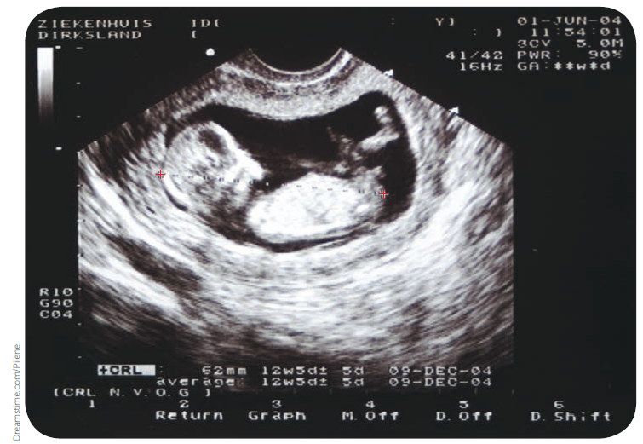
14.2 Diagnosis of foetal health
A range of technologies is available to monitor a foetus and test its health.
Ultrasound
Ultrasound uses inaudible, high-frequency sound waves to produce an image of the foetus. A probe is placed on the abdomen of the pregnant woman, and the sound waves are reflected by the foetal tissues to obtain a visual ‘echo’ of what is inside the uterus. The doctor feeds these reflected sounds, or echoes, into a computer to produce a screen image of the foetus for study.
Ultrasound image of a 12-week-old foetus

Slide 19
14.2 Diagnosis of foetal health
Information that can be gained from ultrasounds include:
Confirming and estimating the stage of pregnancy
determining the number of foetuses
identifying abnormalities of the cervix or uterus
monitoring the growth of the foetus
determining the gender of the foetus
evaluating the anatomy of the foetus
genetic screening
studying the placenta and amniotic fluid
identifying birth defects
determining the position of the foetus.
It is a safe technique but cannot diagnose all abnormalities and, if an abnormality is detected, further tests may be required for more specific information.

Slide 20
14.2 Diagnosis of foetal health
Genetic analysis
Foetal cells can be obtained for analysis using either amniocentesis or chorionic villus sampling. These tests can be used to examine the foetus’s chromosomes to detect defective, missing or additional chromosomes.
Amniocentesis
Amniocentesis is carried out between the 16th and 20th weeks of pregnancy, by which time the foetus is floating in about 130 mL of amniotic fluid. It involves using an ultrasound to guide a needle through the abdominal wall into the amniotic cavity. Approximately 10–20 mL of the fluid is removed.
Living cells from the foetus are floating in the fluid. These cells can be examined for biochemical defects and for abnormalities in the number of chromosomes or in the chromosome structure.

Slide 21
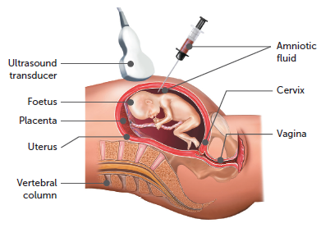
14.2 Diagnosis of foetal health
Amniocentesis involves a small risk of infection, miscarriage or damage to the baby. It is therefore only performed on women who are thought to be at higher risk of delivering a child with a birth defect.
Some of the disorders that can be detected by this procedure are Down syndrome, cystic fibrosis, neural tube defects such as spina bifida, and a wide range of genetic disorders, including phenylketonuria, Tay-Sachs disease, Duchenne muscular dystrophy and sickle cell disease.

Slide 22
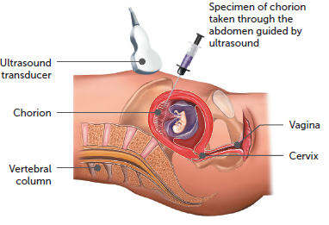
14.2 Diagnosis of foetal health
Chorionic villus sampling (CVS)
CVS obtains a specimen of foetal cells from the chorion, one of the foetal membranes. The cells are then examined in a similar way to those gained by amniocentesis. CVS has an advantage in that testing can take place at 9–19 weeks of pregnancy. In addition, the foetal tissue gained through CVS can be tested more quickly than the specimen of amniotic fluid, reducing the time between the testing procedure and examination of the results.
A disadvantage of CVS is that the risk of miscarriage following the procedure is 2%. CVS can be used to detect genetic disorders and biochemical abnormalities, but it cannot diagnose spina bifida.

Slide 23
14.2 Diagnosis of foetal health
Blood tests
A blood test of the mother’s blood is a non-invasive prenatal test that is possible due to some of the baby’s DNA passing into the mother’s blood. This is a screening test, not a diagnostic one. This means that it is able to identify if there is an increased chance of the baby having a certain disorder; it does not confirm whether the baby definitely has the disorder.
The blood tests are able to screen for:
• Down syndrome (also called trisomy 21)
• Edwards syndrome (trisomy 18)
• Patau syndrome (trisomy 13)
• Turner syndrome.
The blood tests are available from approximately 10 weeks of gestation. If they show an increased chance of an abnormality, an amniocentesis or CVS would be recommended to confirm the diagnosis.

Slide 24
14.2 Diagnosis of foetal health
Foetal monitoring
Foetal monitoring is the regular recording of a baby’s heart rate in order to detect indicators of stress. This monitoring usually takes place during labour and birth using ultrasound and electrocardiography. Electrocardiography is a procedure for recording electrical changes in the heart. The record, which is called an electrocardiogram (ECG), shows the series of waves that relate to the electrical impulses that occur during each beat of the heart. The results are printed on paper or displayed on a monitor.
A detailed foetal heart rate analysis enables medical staff to check whether there is any risk of oxygen deficiency occurring. Oxygen deficiency during birth may result in brain damage, or even a stillbirth.

Slide 25
14.2 Diagnosis of foetal health
Other monitoring and diagnostic techniques
Fetoscopy: used to gain information about a foetus in the uterus. It is a risky procedure that is only performed by a specialist doctor, usually after an ultrasound has indicated the possibility of foetal abnormalities such as spina bifida or Duchenne muscular dystrophy.
Foetal blood sampling: used to diagnose chromosomal abnormalities and foetal anaemia, check foetal oxygenation, identify infections, give medications. Carries higher risks of miscarriage, infection, blood loss and premature rupture of the amniotic sac.
Biochemical analysis: used to detect phenylketonuria (PKU), either by testing the blood for excessive amounts of phenylalanine or by analysing the urine for phenylpyruvic acid. Another marker protein is alpha-fetoprotein (AFP), which can be measured in samples of amniotic fluid.
DNA probes: enables the detection of a range of genetic disorders, such as Duchenne muscular dystrophy and thalassaemia. The probes are based on recombinant DNA technology.

